Slide 1





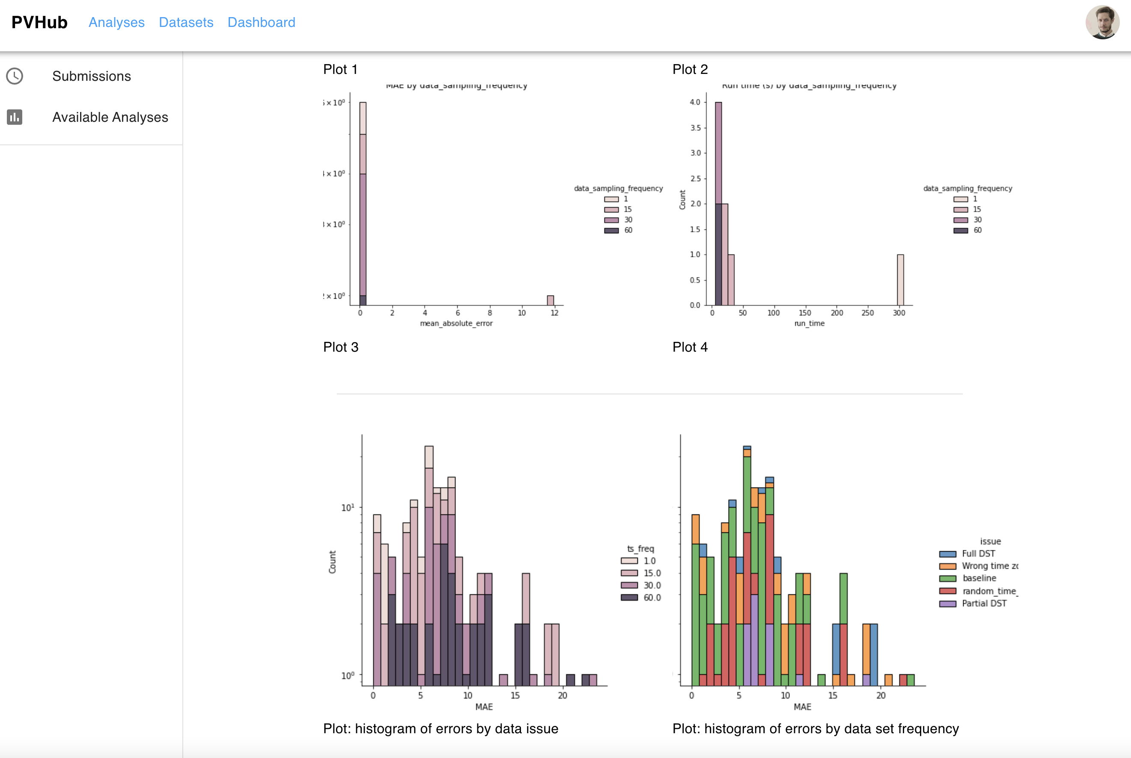
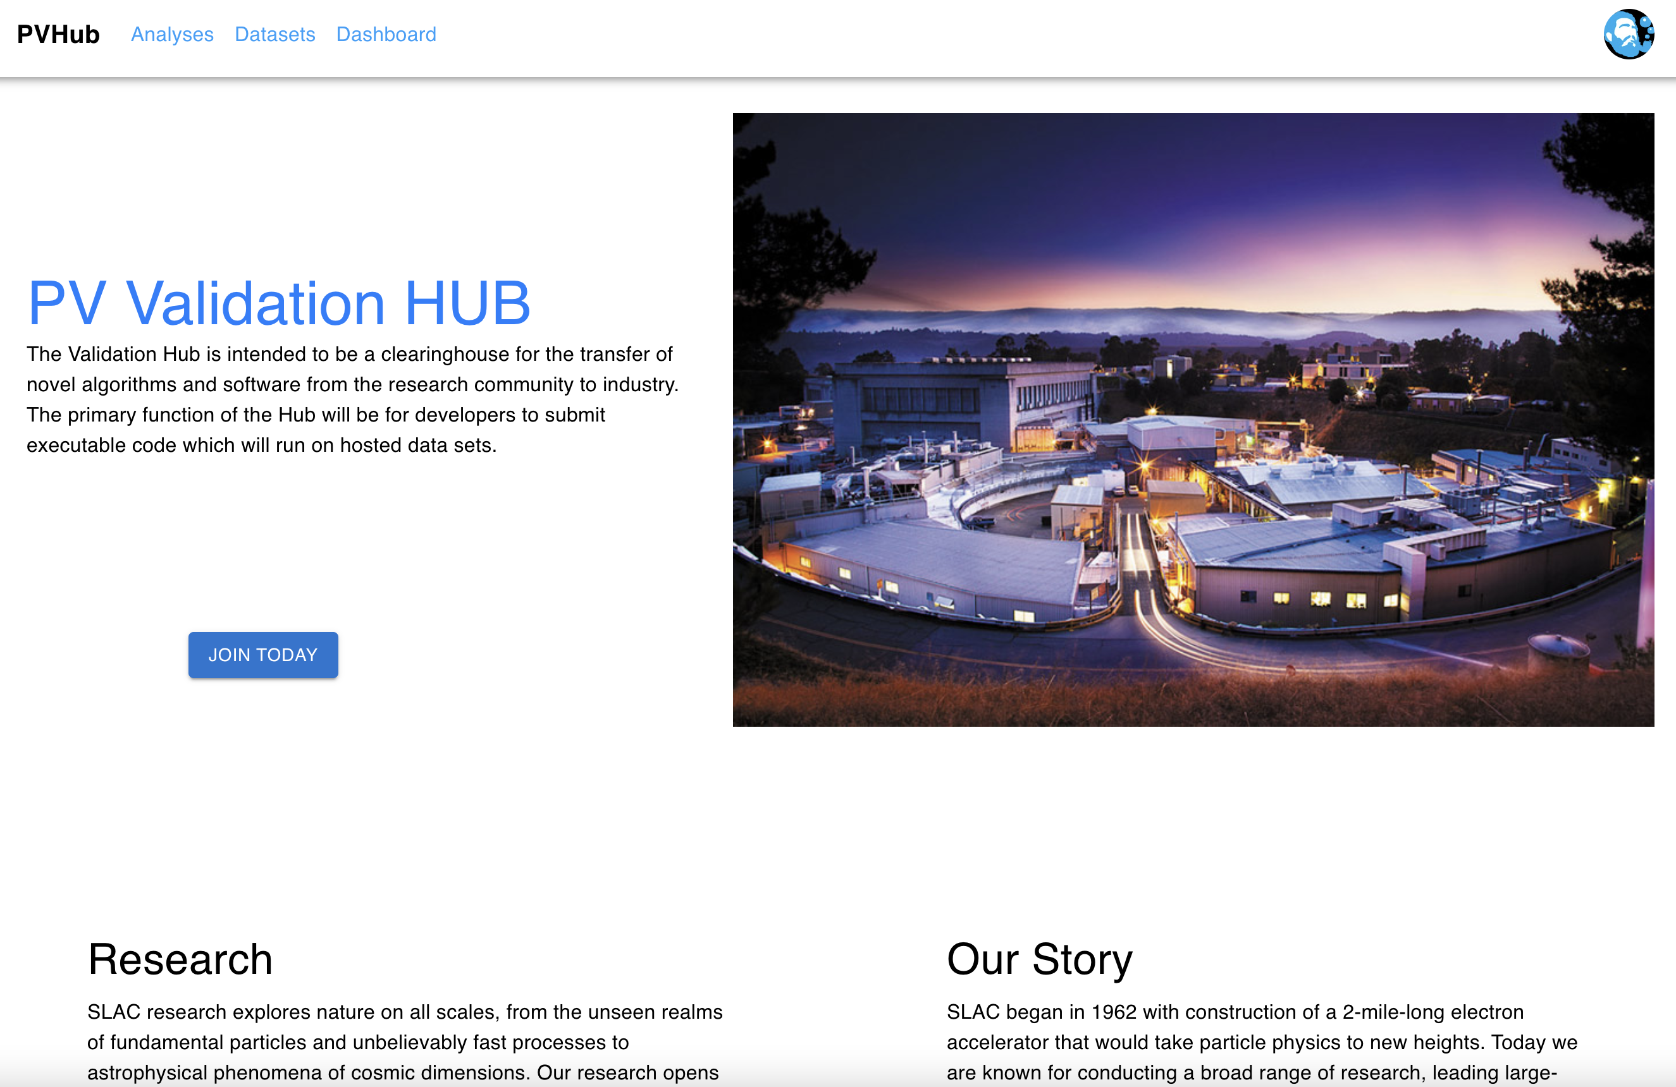
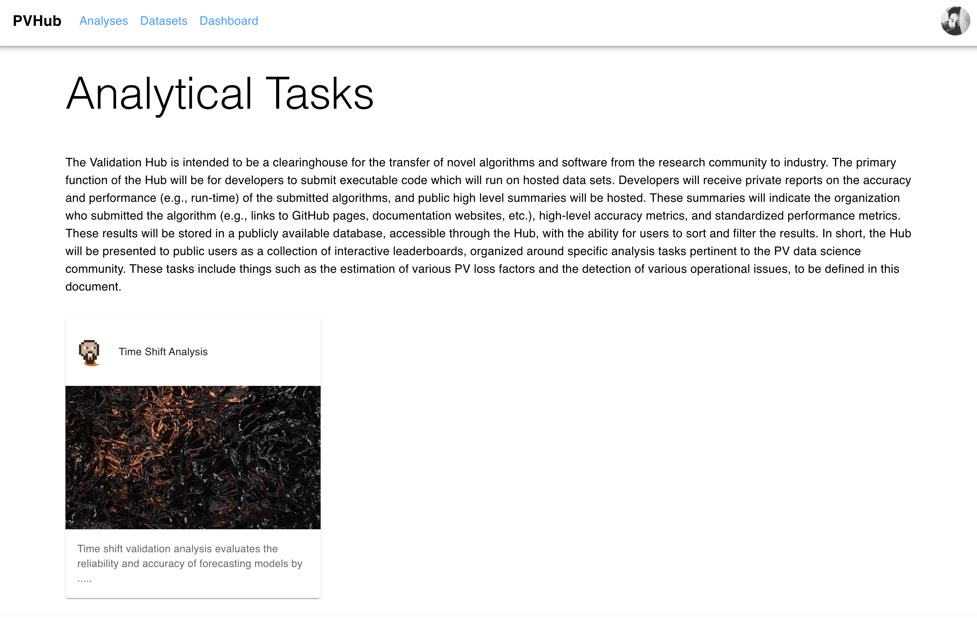
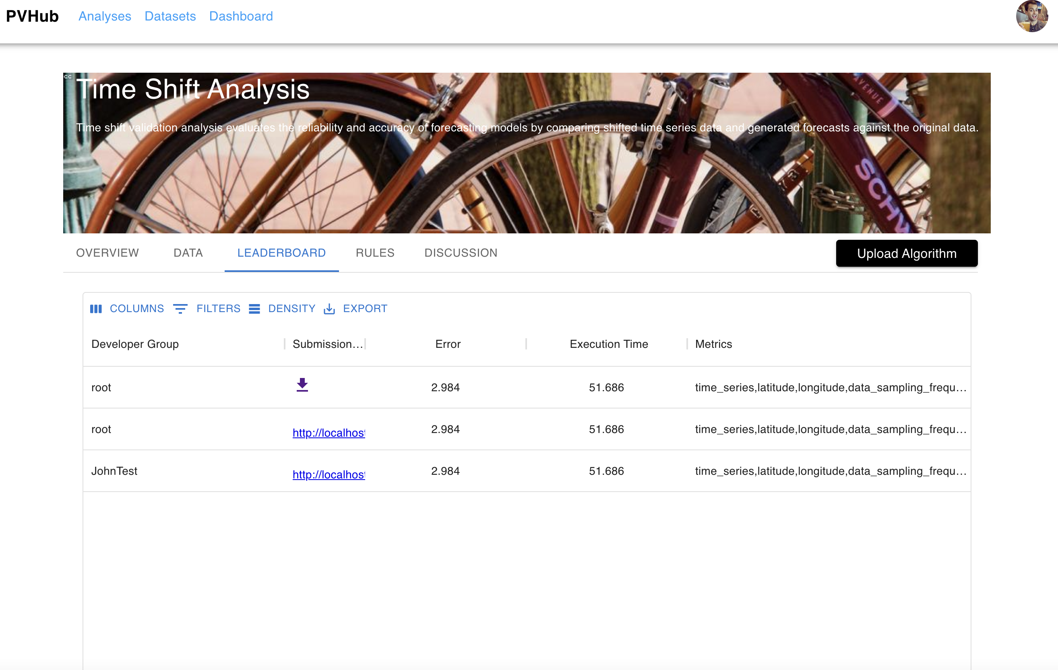
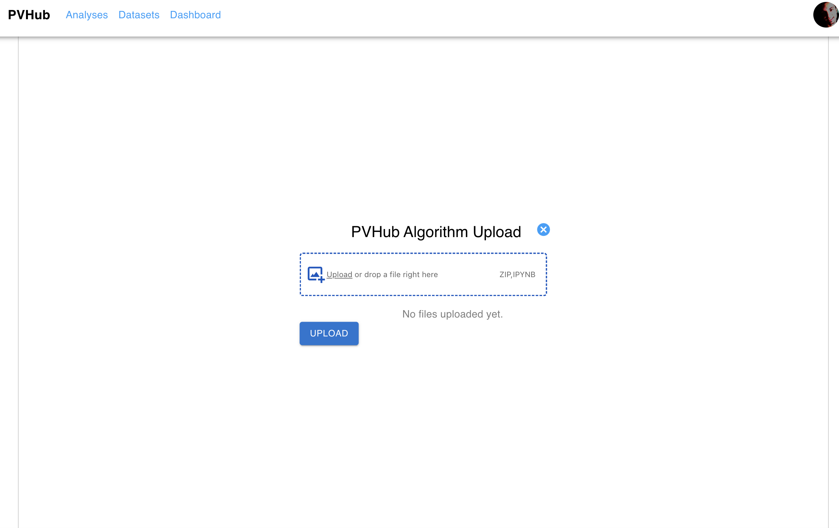
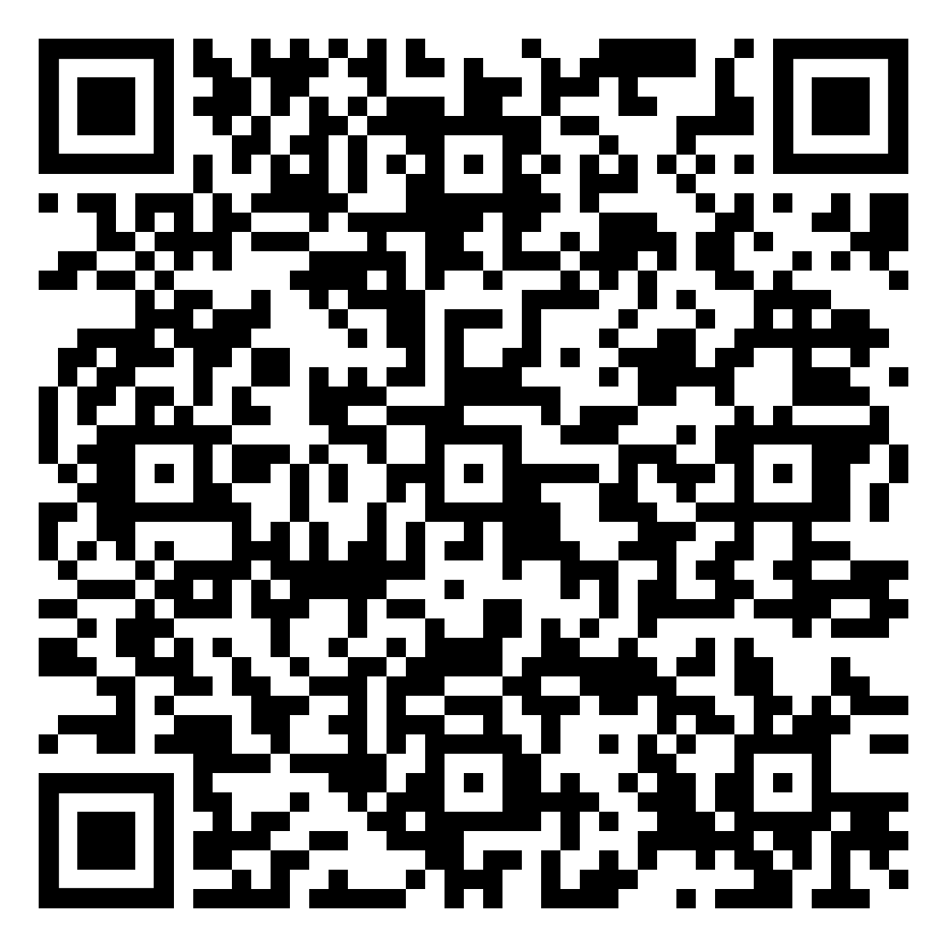
Funded by:
PV Validation Hub
Bennet Meyers¹, Duncan Ragsdale¹, Kirsten Perry², Michael Deceglie², Matthew Muller², Mehmet Ogut³, Sara Miskovich¹, Mayank Malik¹
(1) SLAC National Accelerator Laboratory, Menlo Park, CA 94025, USA
(2) National Renewable Energy Laboratory, Golden, CO 80401, USA
(3) Stanford University, Palo Alto, CA 94305, USA
Purpose
Algorithm Validation
Allow developers to submit PV analytics algorithms for validation.
Degradation, soiling, tilt/azimuth estimation, etc.
Well-curated validation data sets and procedures
Consistent labeled data sets allow for side-by-side comparison of different algorithms
Public leaderboards and documentation facilitate tech transfer
Enables rapid development and benchmarking of solar algorithms
Plans to generate validation tests for the following types of analyses:
Estimating system degradation
Estimating soiling rate/ratio
Detecting time zone/shift issues
Estimating azimuth and tilt of a PV system
Determining inverter ‘clipping’ intervals
And more!
Robust Ground Truth Data Sets
Labeled measured data
Synthetic data sets with typical field data issues (capacity issues, outages, soiling, shading, etc.)
Validation Hub algorithm submission process
Create account
Submit code for designated analysis
Code runs on validation engine
Leaderboard updated
Private report sent to developer
Validation Hub In Action
Plan to have the Validation Hub available for public use by the end of 2023 (tentatively)
Currently benchmarking functions in the Python Solar-Data-Tools and PVAnalytics packages and using this as a framework for initial testing in the Validation Hub
Validation Hub User Roles
Developer Role
Public reporting: Scoreboard benchmarking all submitted algorithms’ performance
Private reporting: Detailed results returned to the developer, including how the algorithm performs in certain scenarios (ex: data at different sampling frequencies)
User Role
View leaderboards and access submitted algorithm solutions for each category
Prototype website screenshots:
Private report mockup
Main page of the site
Page to scroll through different analytical tasks
Take our feedback survey!
Public leaderboard mockup
Algorithm upload page
This work was authored by SLAC National Accelerator Laboratory, the National Renewable Energy Laboratory, and Stanford University. Funding provided by U.S. Department of Energy Office of Energy Efficiency and Renewable Energy Solar Energy Technologies Office under agreement 38529. The views expressed in this poster do not necessarily represent the views of the DOE or the U.S. Government. The U.S. Government retains and the publisher, by accepting the poster for publication, acknowledges that the U.S. Government retains a nonexclusive, paid-up, irrevocable, worldwide license to publish or reproduce the published form of this work, or allow others to do so, for U.S. Government purposes.

